Slide 1
Company Network with VLANs and Inter-VLAN Routing

Slide 2
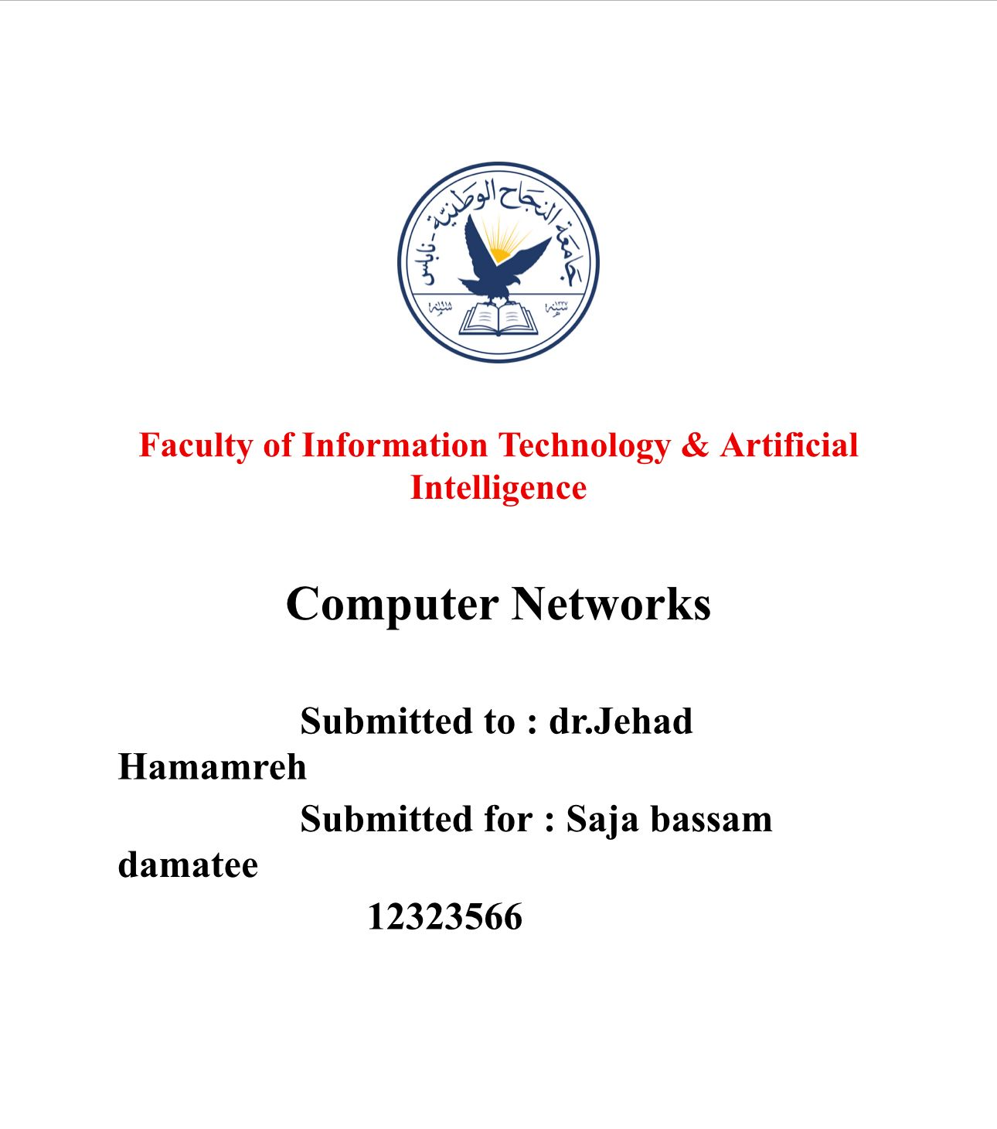

Slide 3
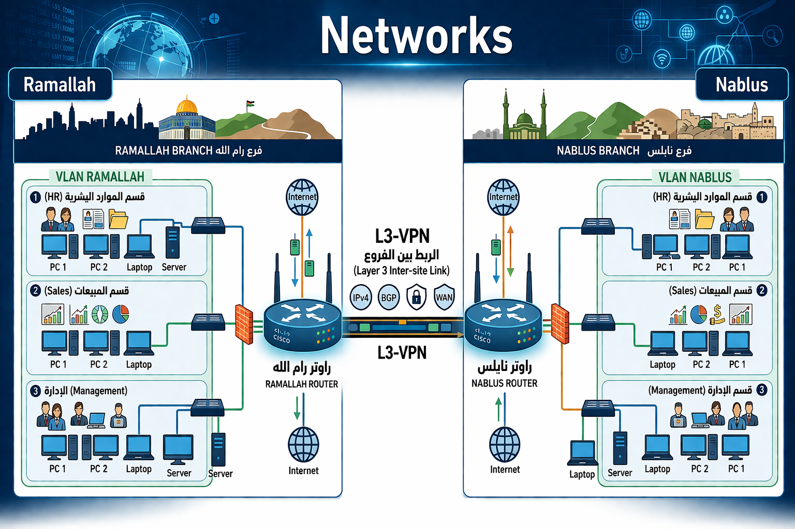

Slide 4
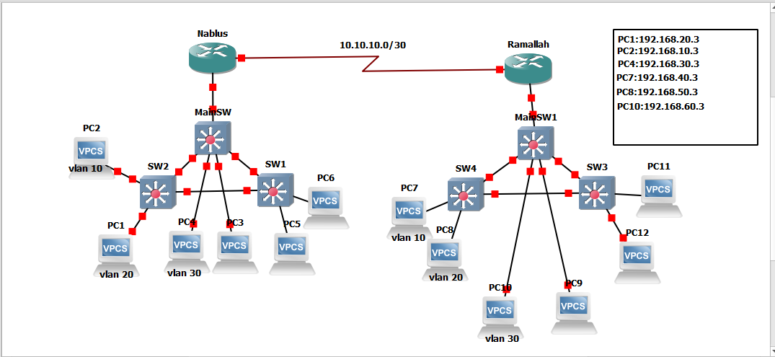

Slide 5
Project Overview
Design a company network using VLANs
Implement Inter-VLAN Routing
Use GNS3 for simulation

Slide 6
Objectives
Segment the network
Improve security
Reduce broadcast traffic
Enable communication between departments

Slide 7
Network Topology
Two routers (Ramallah & Nablus)
Multiple switches
Several PCs
Departments separated logically

Slide 8
What is VLAN
VLAN = Virtual Local Area Network
Divides one physical network into multiple logical networks
Each VLAN is isolated

Slide 9
VLANs Used
VLAN 10 → HR
VLAN 20 → SALES
VLAN 30 → MANAGEMENT

Slide 10
IP Addressing
HR → 192.168.10.0/24
SALES → 192.168.20.0/24
MANAGEMENT → 192.168.30.0/24

Slide 11
Inter-VLAN Routing
Used Router-on-a-Stick
Created Subinterfaces
Each VLAN has its own gateway

Slide 12
Trunking
Connects switches together
Carries multiple VLANs
Uses 802.1Q encapsulation

Slide 13
Configuration Steps
Create VLANs
Assign switch ports
Configure trunk links
Setup router interfaces
Assign IPs to PCs

Slide 14
Testing
Ping between devices
Test communication across VLANs
Verify routing

Slide 15
Problems Faced
Native VLAN mismatch
Trunk encapsulation errors
Wrong IP configuration

Slide 16
Solutions
Set same native VLAN
Use dot1Q encapsulation
Verify gateway addresses

Slide 17
Conclusion
Network successfully segmented
VLANs implemented correctly
Inter-VLAN routing working

